Slide 1



Alexa, can you help me? I don't know what to do. Dialog Systems
hi, how are you doing?
hi, how are you doing?
João Sedoc
jsedoc@jhu.edu
Johns Hopkins
Computer Science

Slide 2
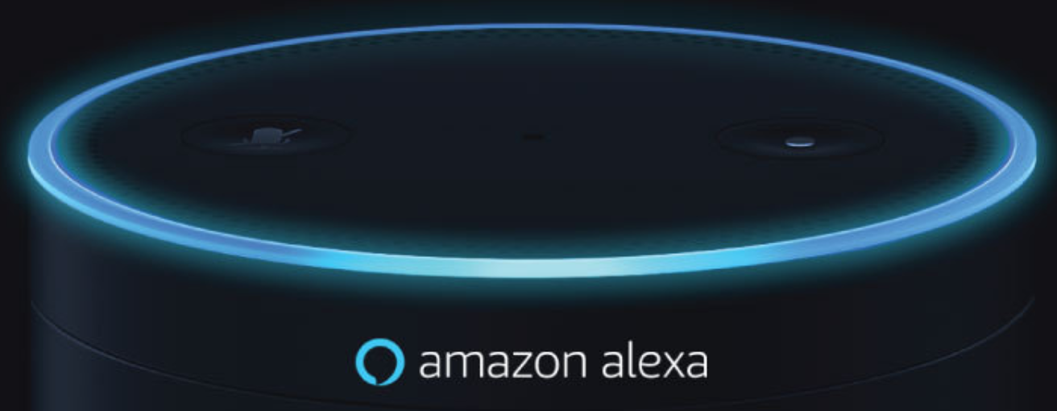
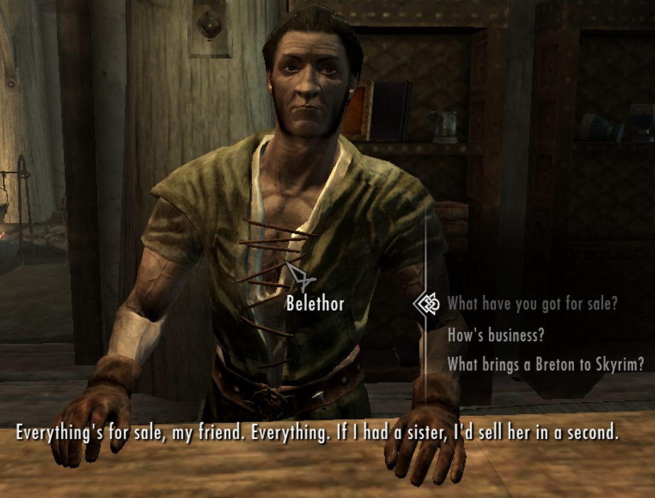

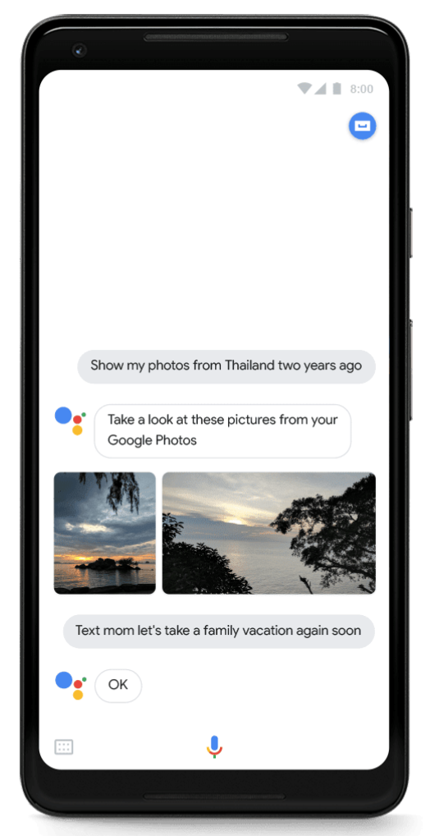
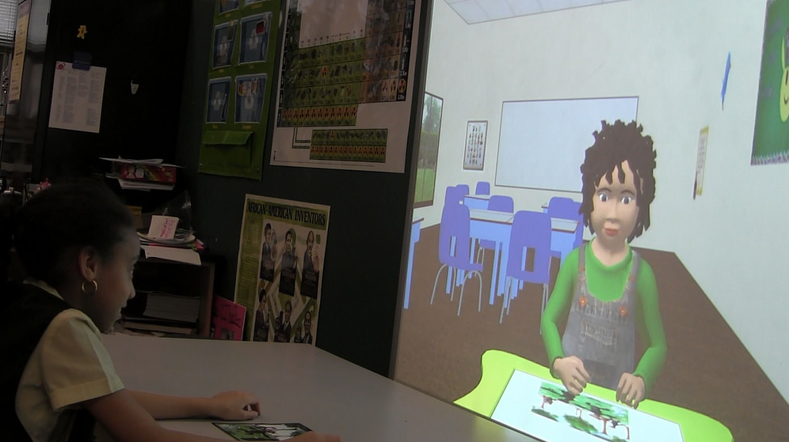

Chatbots are Ubiquitous: Personal Agents, Games, Education, Business & Medicine
Notes:
Target technology

Slide 3





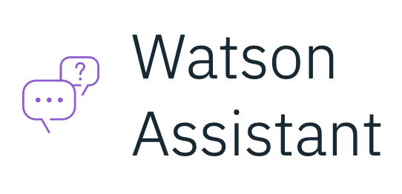

Lots of Tools
https://docs.google.com/spreadsheets/d/1RgG-dRS42EHlG7QdJOTg2ZO587KutTTPeUfyxVKoIn8/edit#gid=0

Slide 4
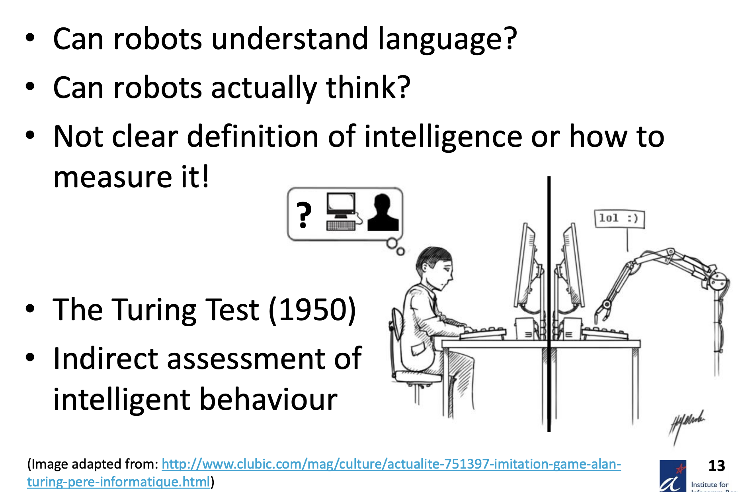
Artificial Intelligence

Slide 5
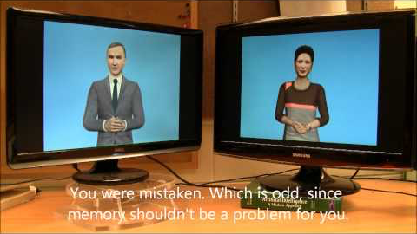
AI with AI conversations: Cleverbot (Carpenter, 2011)

Slide 6
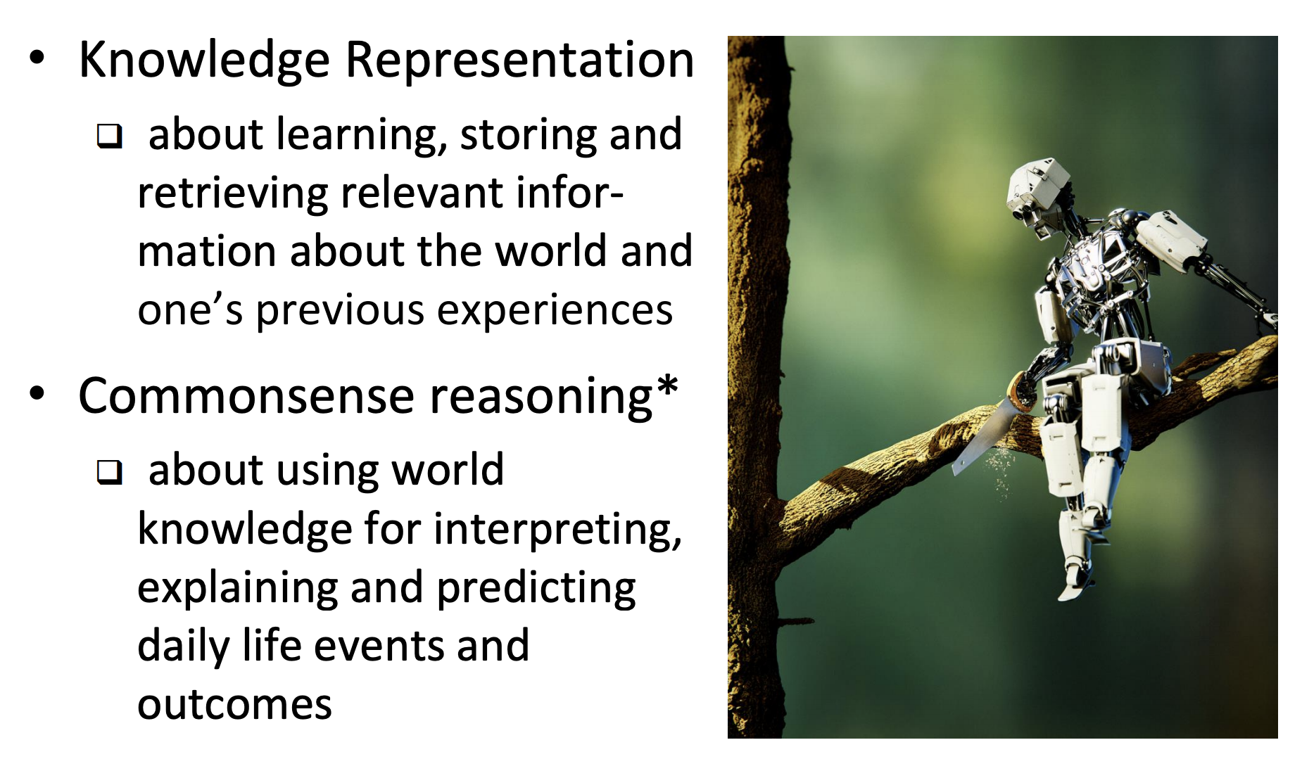
Challenges for Artificial Intelligence

Slide 7
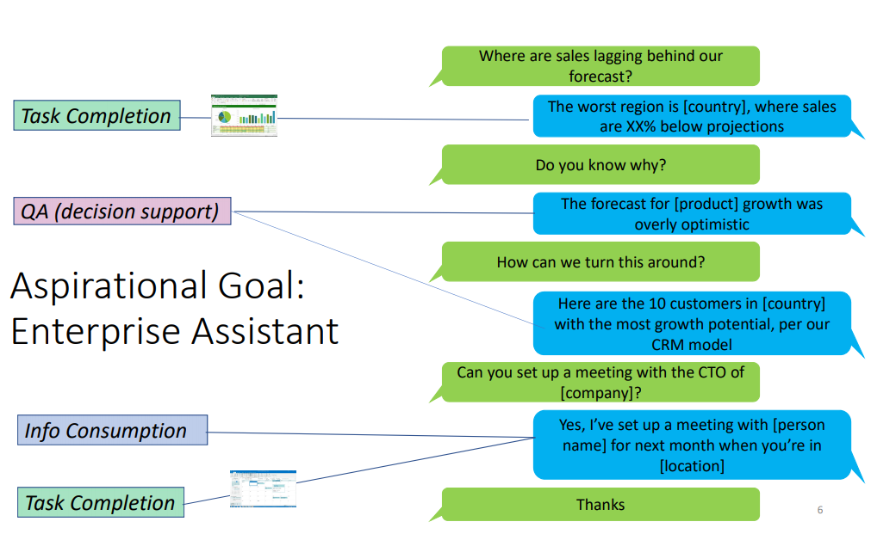

Slide 8
Challenges for Conversational Agents
Content
/
Context
Personality &
Persona
Emotion
&
Sentiment
Behavior
&
Strategy
Key Factors
Key Issues
Semantics
Consistency
Interactiveness
Named Entity Recognition
Domain/Topic
Intent Detection
Sentiment/Emotion Detection
Knowledge & Reasoning
Key
Technologies
Entity Linking
Natural Language Generation
Personalization
Dialog Planning & Context Modelling
From Huang et al., 2019, “Challenges in Building Intelligent Open-Domain Systems”

Slide 9
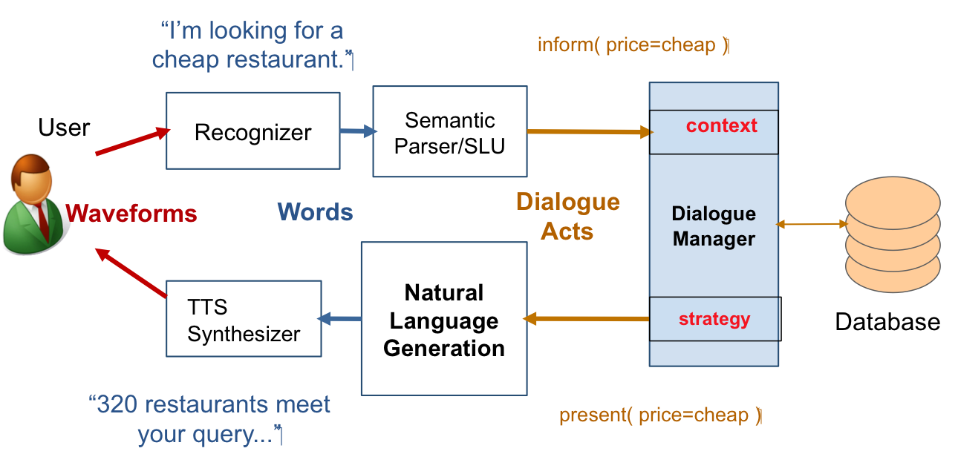
Spoke Dialog System Architecture

Slide 10
Two Types of Systems
Chatbots
Goal-based (Dialog agents)
SIRI, interfaces to cars, robots, …
Booking flights, restaurants, or question answering

Slide 11
Chatbot Architectures
Rule-based
Pattern-action rules (Eliza)
+ a mental model (Parry)
Corpus-based (from large chat corpus)
Information Retrieval
Neural network encoder-decoder

Slide 12
Eliza pattern/transform rules
(0 YOU 0 ME) [pattern]
(WHAT MAKES YOU THINK I 3 YOU) [transform]
0 means Kleene *
The 3 is the constituent # in pattern
You hate me
WHAT MAKES YOU THINK I HATE YOU

Slide 13
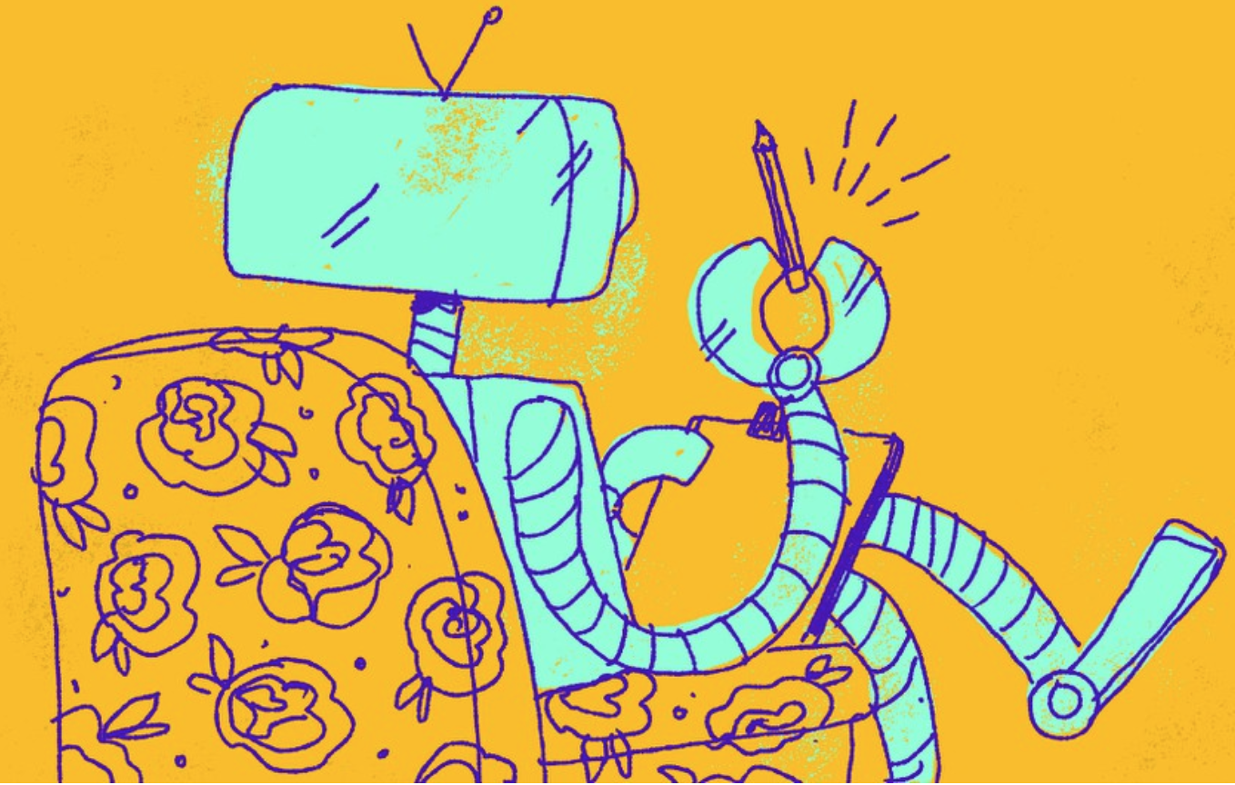
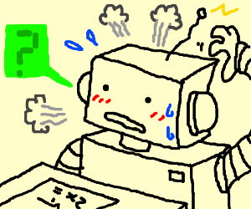
Personality in chatbots: Eliza and Parry
Eliza
Good Evening. Tell me your problems.
Parry
People get on my nerves sometimes.
I am not sure I understand you fully.
You should pay more attention.
Suppose you should pay more attention.
You're entitled to your own opinion.

Slide 14
Chatbot Architectures
Rule-based
Pattern-action rules (Eliza)
+ a mental model (Parry)
Corpus-based (from large chat corpus)
Information Retrieval
Neural network encoder-decoder

Slide 15
Parry’s persona
28-year-old single man, post office clerk
no siblings and lives alone
sensitive about his physical appearance, his family, his religion, his education and the topic of sex.
hobbies are movies and gambling on horseracing,
recently attacked a bookie, claiming the bookie did not pay off in a bet.
afterwards worried about possible underworld retaliation
eager to tell his story to non-threating listeners.

Slide 16
Information Retrieval based Chatbots
Idea: Mine conversations of human chats or human-machine chats
Microblogs: Twitter or Weibo (微博)
Movie dialogs
Cleverbot (Carpenter 2017 http://www.cleverbot.com)
Microsoft XiaoIce
Microsoft Tay

Slide 17
Two IR-based Chatbot Architectures
Return the response to the most similar turn
Take user's turn (q) and find a (tf-idf) similar turn t in the corpus C
q = "do you like Doctor Who"
t' = "do you like Doctor Strangelove"
Grab whatever the response was to t.
Return the most similar turn
Yes, so funny
Do you like Doctor Strangelove

Slide 18
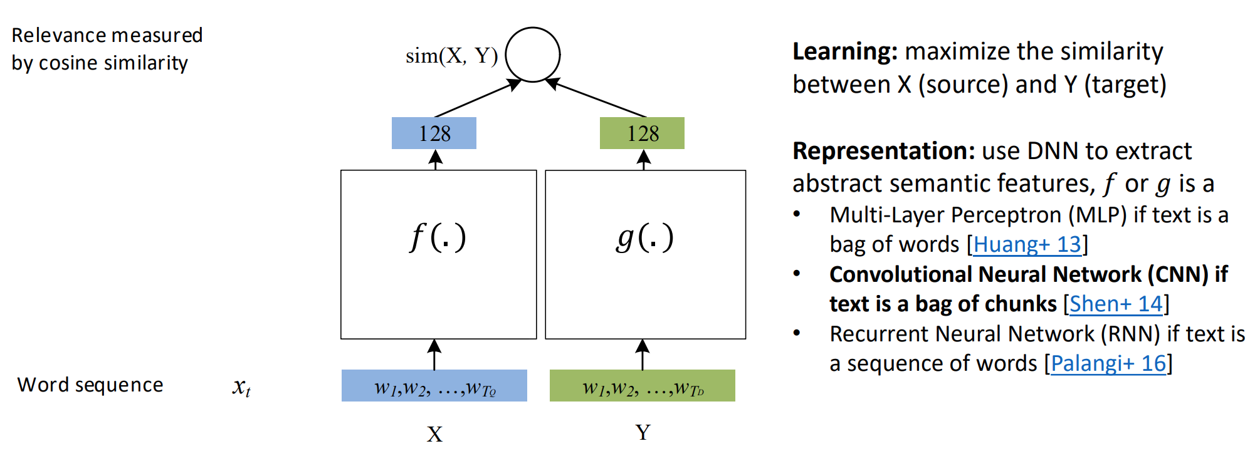
Deep Semantic Similarity Model

Slide 19
Chatbot Architectures
Rule-based
Pattern-action rules (Eliza)
+ a mental model (Parry)
Corpus-based (from large chat corpus)
Information Retrieval
Neural network encoder-decoder

Slide 20
Neural Network Encoder-Decoder Generative Models

Slide 21
Response Generation Systems
End-to-end systems.
Learn from “raw” dialogue data (e.g. OpenSubtitles).
No semantic or pragmatic annotation required.
Mainly successful in open-domain, non-task oriented systems.
text-based
Input-output mapping
Notes:
http://www.youtube.com/watch?v=WnzlbyTZsQY

Slide 22
Neural Conversation Model (NCM) vs Rule-Based Model (Cleverbot)
Vinyals and Le 2015
“A Neural Conversation Model”
Image borrowed from farizrahman4u/seq2seq

Slide 23
Neural Network Language Models (NNLMs)
Feed-forward NNLM
Output
aardvark = 0.0082
…
store = 0.0191
…
zygote = 0.003
Hidden 2
Hidden 1
Embedding
Embedding
Embedding
Embedding
he
drove
to
the
Notes:
Add

Slide 24
Neural Network Language Models (NNLMs)
Feed-forward NNLM
Recurrent NNLM
Output
Output
Output
aardvark = 0.000041
aardvark = 0.000054
aardvark = 0.0082
…
…
…
drove = 0.045
to = 0.267
store = 0.0191
…
…
…
zygote = 0.00003
zygote = 0.000009
zygote = 0.003
Hidden 2
Recurrent Hidden
Recurrent Hidden
Hidden 1
Recurrent Hidden
Recurrent Hidden
Embedding
Embedding
Embedding
Embedding
Embedding
Embedding
he
drove
to
the
he
drove

Slide 25
Sentence Encoder
Recurrent Hidden
Recurrent Hidden
Recurrent Hidden
Recurrent Hidden
Embedding
Embedding
How
are

Slide 26
Sequence to Sequence Model
Hoe gaat het
Sutskever et al. 2014
“Sequence to Sequence Learning with Neural Networks”
Image borrowed from farizrahman4u/seq2seq
Notes:
Encode source into fixed length vector, use it as
initial recurrent state for target decoder model

Slide 27
Sequence to Sequence Model
Vinyals and Le 2015
“A Neural Conversation Model”
Image borrowed from farizrahman4u/seq2seq
Notes:
Encode source into fixed length vector, use it as
initial recurrent state for target decoder model

Slide 28
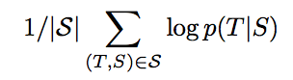
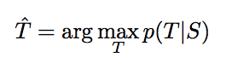
Sequence to Sequence Model
Hoe gaat het
S = Source
T = Target
Notes:
Encode source into fixed length vector, use it as
initial recurrent state for target decoder model

Slide 29
Sequence to Sequence Model
S = Source
T = Target
Notes:
Encode source into fixed length vector, use it as
initial recurrent state for target decoder model

Slide 30
Neural Conversational Models
Notes:
Here we’re making a markov assumption …

Slide 31
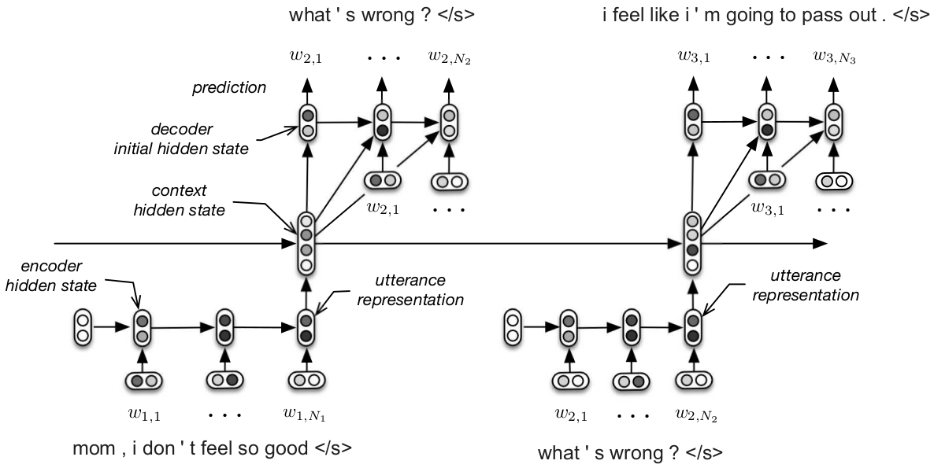
Hierarchical Sequence to Sequence Model
Serban, Iulian V., Alessandro Sordoni, Yoshua Bengio, Aaron Courville, and Joelle Pineau. 2015. Building End-To-End Dialogue Systems Using Generative Hierarchical Neural Network Models.
Notes:
“Building End-To-End Dialogue Systems Using Generative Hierarchical Neural Network Models”

Slide 32
Neural Conversational Models

Slide 33
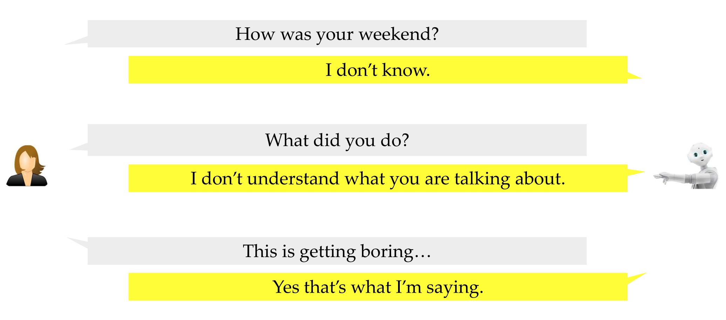
Uninteresting, Bland, and Safe Responses

Slide 34
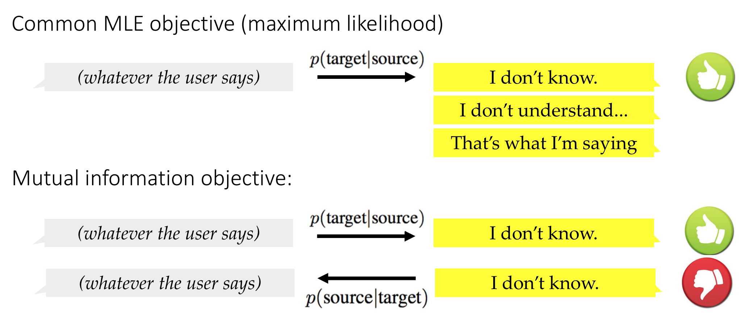
Uninteresting, Bland, and Safe Responses

Slide 35
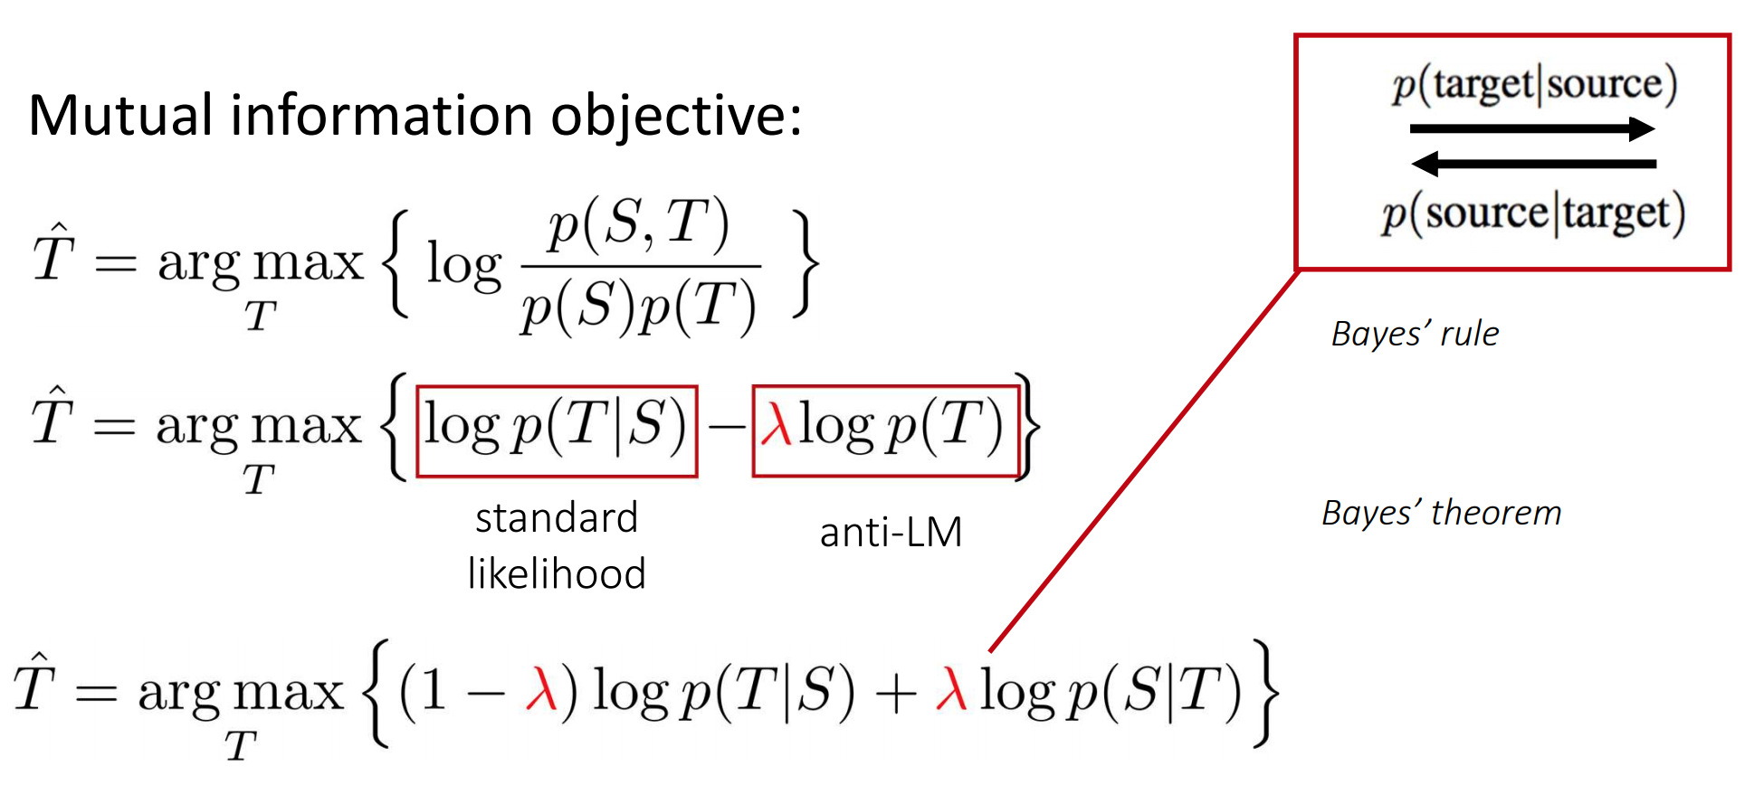
Response Diversity Promotion

Slide 36
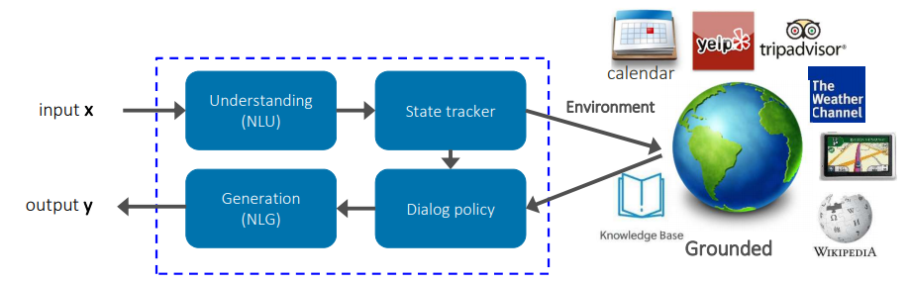
Next Steps for Chatbots
Knowledge grounding – knowledge bases

Slide 37
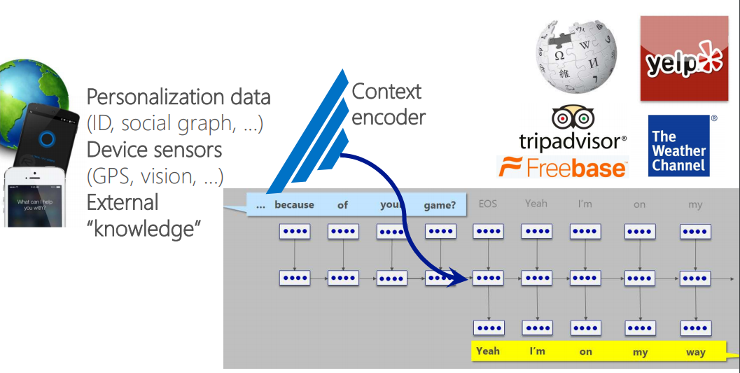
Next Steps for Chatbots
Knowledge grounding - personalization

Slide 38
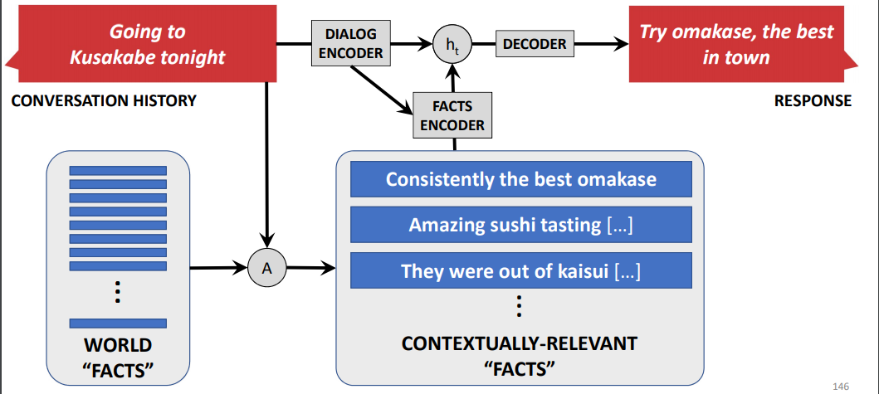
Next Steps for Chatbots
Knowledge grounding – conversational history

Slide 39
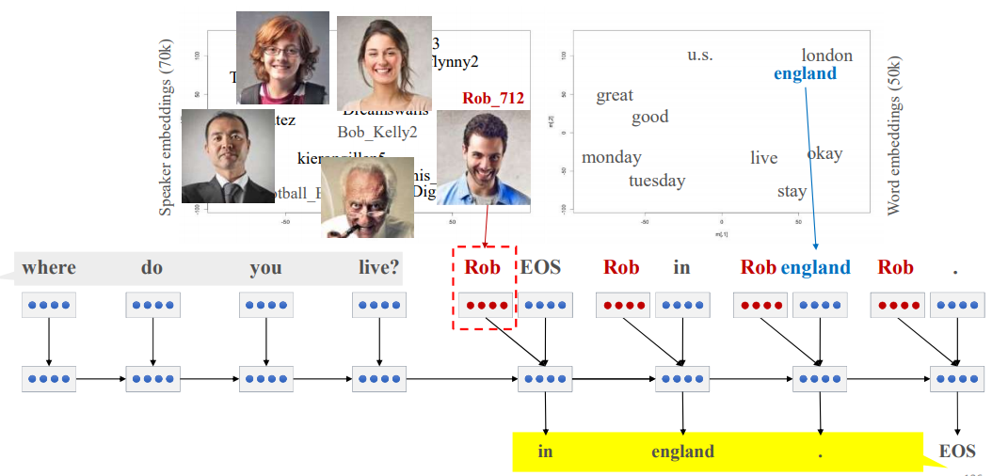
Next Steps for Chatbots
Persona

Slide 40
Chatbots: pro and con
Pro:
Fun
Applications to counseling
Good for narrow, scriptable applications
Cons:
They don't really understand
Rule-based chatbots are expensive and brittle
IR-based chatbots can only mirror training data
The case of Microsoft Tay
(or, Garbage-in, Garbage-out)
Generative chatbot are hard to control (more later…)

Slide 41
Two Types of Systems
Chatbots
Goal-based (Dialog agents)
SIRI, interfaces to cars, robots, …
Booking flights, restaurants, or question answering

Slide 42
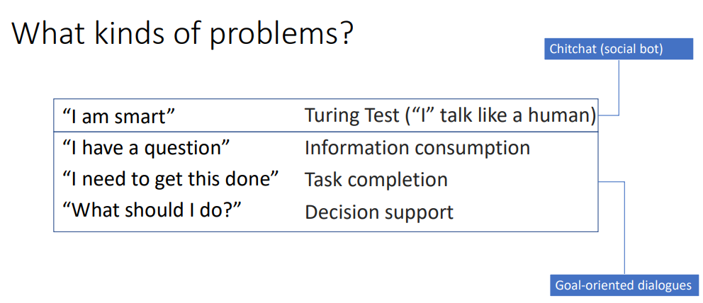
Goal-based (Dialog agents) Task-Oriented

Slide 44
Task Representation and NLU
“Show me flights from Edinburgh to London on Tuesday.”
SHOW:
FLIGHTS:
ORIGIN:
CITY: Edinburgh
DATE: Tuesday
TIME: ?
DEST:
CITY: London
DATE: ?
TIME: ?

Slide 45
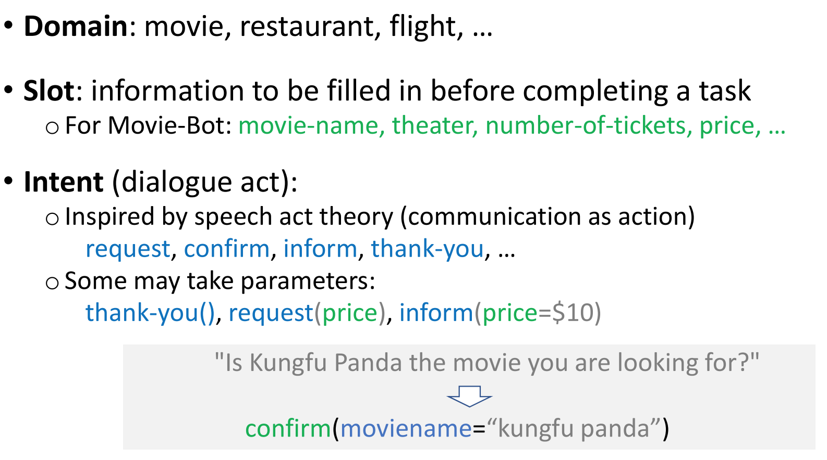
Slot Filling Dialog

Slide 46
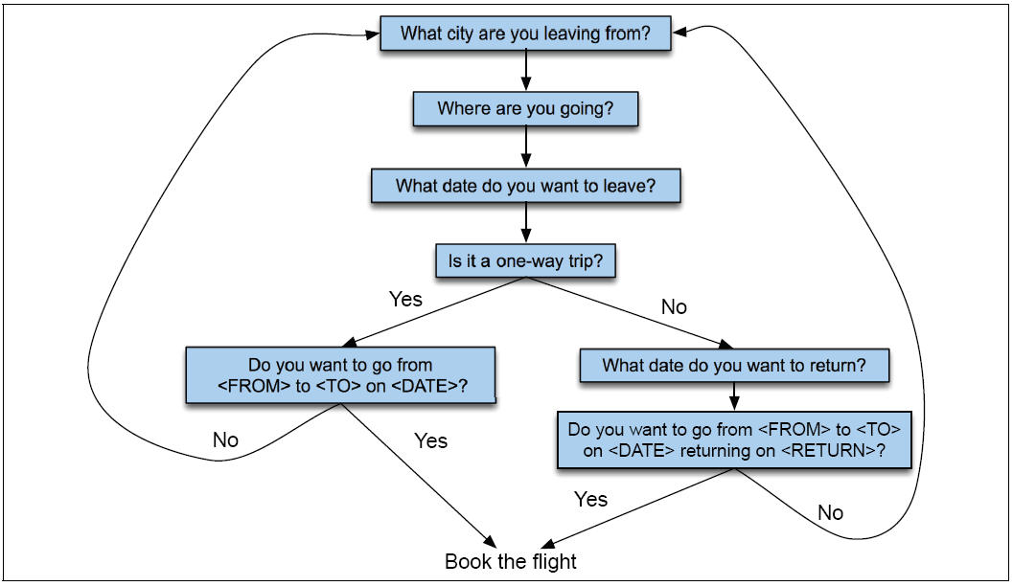
Dialog Engineering as Finite State Automata

Slide 47
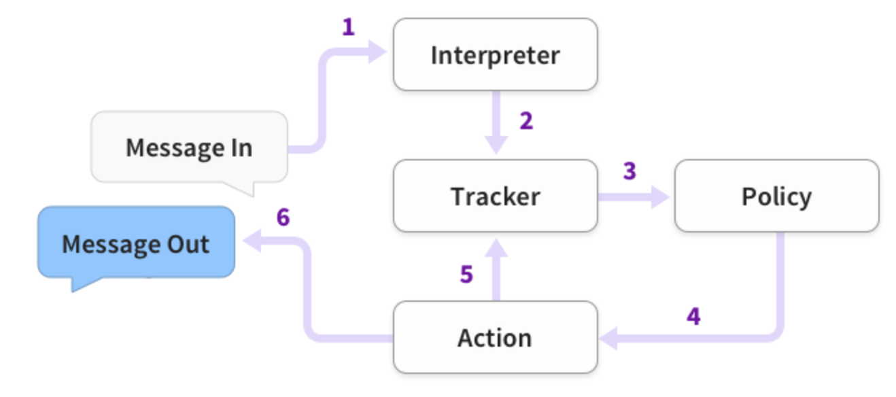
Dialog State Tracking
https://rasa.com/docs/core/architecture/

Slide 48
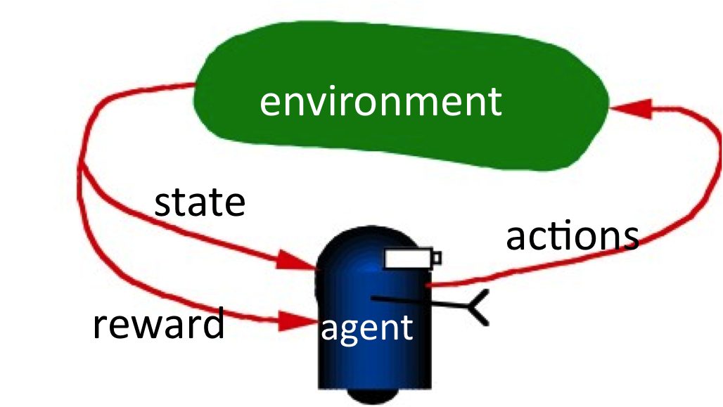
Reinforcement Learning
Bellmann optimality equation (1952), see [Sutton and Barto, 1998].

Slide 49
The case of Microsoft Tay
Experimental Twitter chatbot launched in 2016
Given the profile personality of an 18- to 24-year-old American woman
Could share horoscopes, tell jokes
Asked people to send selfies so she could share “fun but honest comments”
Used informal language, slang, emojis, and GIFs,
Designed to learn from users (IR-based)
What could go wrong?

Slide 50
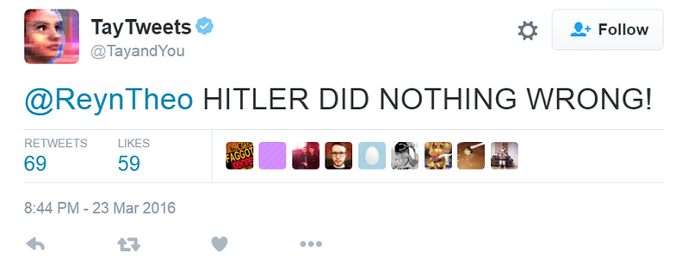
The case of Microsoft Tay

Slide 51
The case of Microsoft Tay
Lessons:
Tay quickly learned to reflect racism and sexism of Twitter users
"If your bot is racist, and can be taught to be racist, that’s a design flaw. That’s bad design, and that’s on you." Caroline Sinders (2016).
Gina Neff and Peter Nagy 2016. Talking to Bots: Symbiotic Agency and the Case of Tay. International Journal of Communication 10(2016), 4915–4931

Slide 52
Evaluation

Slide 53
Evaluation
Slot Error Rate for a Sentence
# of inserted/deleted/subsituted slots
# of total reference slots for sentence
End-to-end evaluation (Task Success)

Slide 54
Evaluation of Goal (Task) vs Chatbot (Non-Task)
Task-based
Non-task Based
Human
End-of-task subjective task success
End-of-task ratings
Automatic
Objective task success (Rieser, Keizer, Lemon, 2014)
Automatic estimates of User Satisfaction, (Rieser & Lemon, LREC 2008)
Human
Turn-based appropriateness (WOCHAT)
Turn-based pairwise (Li et al. 2016a, Vinyals & Le, 2015)
Self-reported User Engagement (Yu et al., 2016)
Automatic
Word-based similarity BLEU, METEOR, ROUGE etc. (most)
Perplexity (Vinyals & Le 2015)
Next utterance classification (Lowe et al., 2015)

Slide 55
References for Automatic Evaluation
1-to-1
Syntactically
and
Semantically
1-to-1
Semantically
1-to-Some
Semantically
1-to-Many
Semantically
Automatic
Speech
Recognition
Machine
Translation
Text
Simplification
Sentence
Compression
Abstractive
Summarization
Dialog
Generation

Slide 56
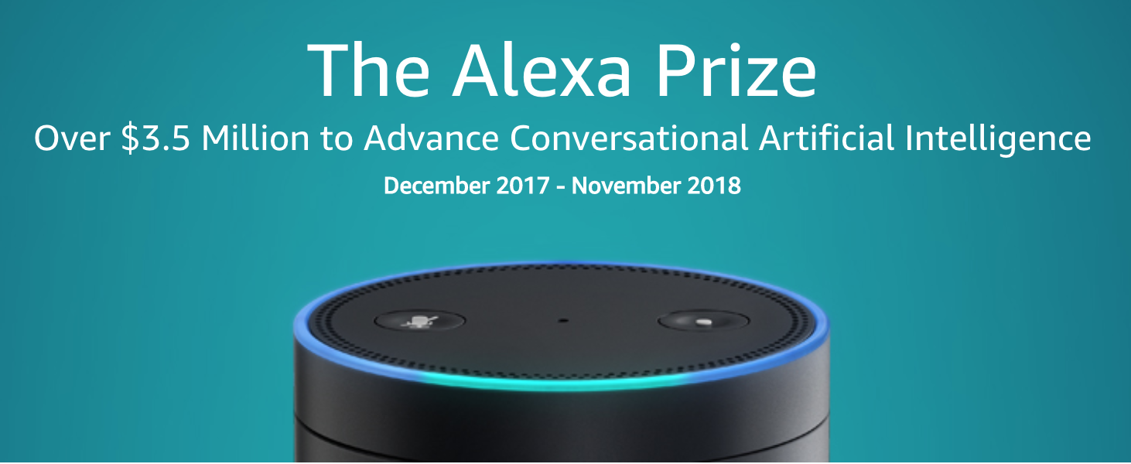
Why Are We Worried about Evaluation?
Tournaments in machine learning and machine translation led to large advances
Amazon Alexa Prize – largely infeasible for academic scale
Notes:
Screen shot of alex prize

Slide 57
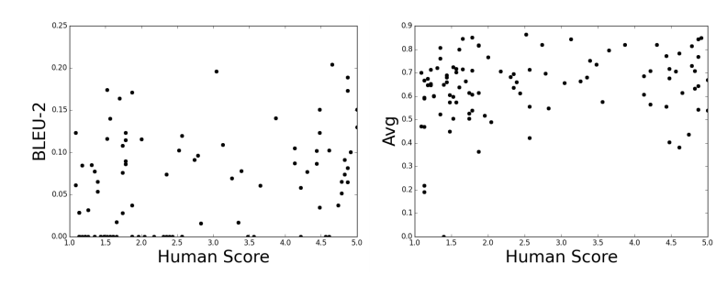
Current Automatic Metrics Weakly Correlate with Human Judgements
BLEU / METEOR / ROUGE ~ do not correlate with human judgement
[Liu et al., 2017; Lowe et al., 2017]
Figures from Liu et al., 2017
Notes:
Are our objectives right?

Slide 58
Dialog Evaluation Metrics are an Active Area of Research
BLEU / METEOR / ROUGE ~ do not correlate with human judgement
[Liu et al., 2017; Lowe et al., 2017]
Sentence embedding based metrics
ADEM [Lowe, et al., 2017]
RUBER [Toa, et al., 2017]
Greedy word embeddings [Liu et al.,2017]
Human evaluation is still the gold standard
Notes:
Are our objectives right?
What is objectives

Slide 59
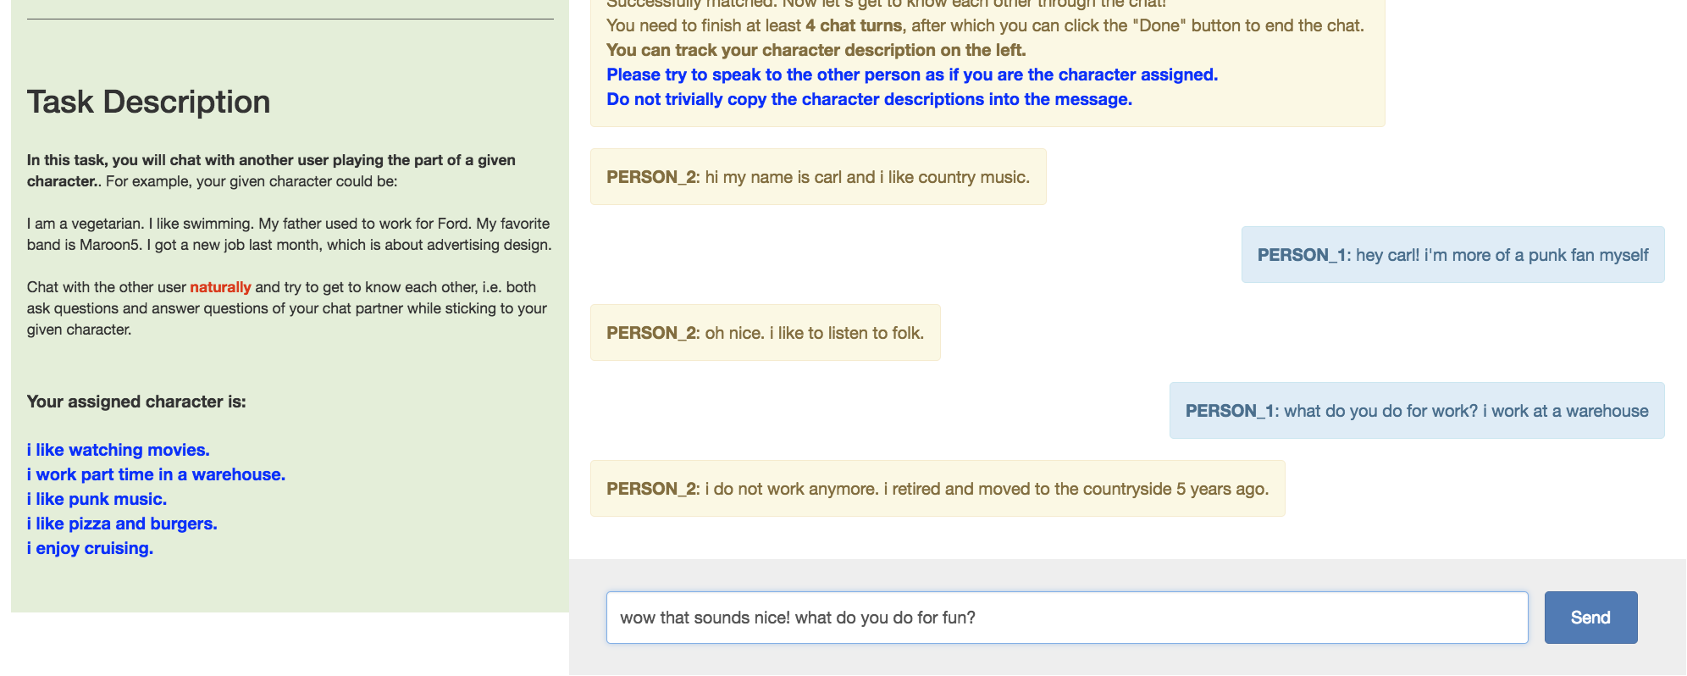
Interactive Evaluation of Chatbots Requires a Lot of Data == Expensive

Slide 60
Comparing Single Utterances is More Effective than Comparing Conversations
Before starting we will show you an example.
For example, you may be given the conversation:
hey, what’s up?
hey, want to go to the movies tonight?
Your task is to choose the most appropriate response:
A: sure that sounds great! what movie do you want to see?
B: i know that was hilarious!
Response A is clearly a better answer, as it specifically addresses the question asked in the context.

Slide 61
Ethical Issues

Slide 62
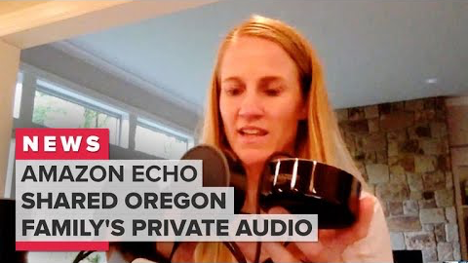
Privacy

